Slide 1
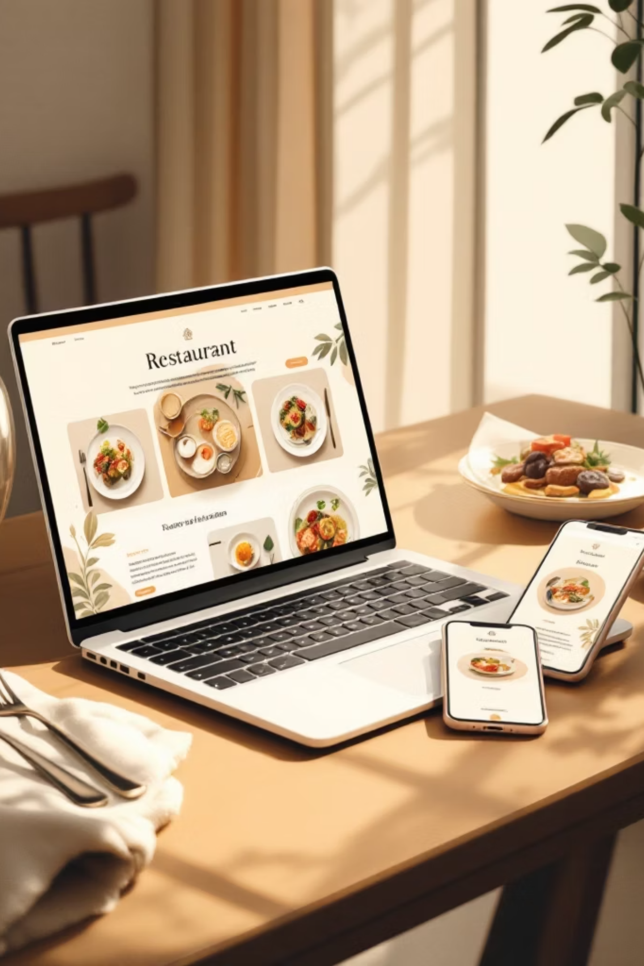
🎓 COLLEGE PROJECT · WEB DEVELOPMENT
Designing & Developing a Restaurant Menu Ordering Website
Created By: Ennuhang Rai.

Slide 2

Project Overview & Goals
Seamless Ordering
Responsive Performance
Deliver an intuitive ordering flow that minimizes friction from browsing to checkout.
Fast load times and adaptive layouts across phones, tablets, and desktops.
Scalable Backend
Maintainability
Modular API and data models to support growth, integrations, and analytics.
Clear code structure, automated tests, and admin tools for non-technical staff.
The project balances user delight with operational efficiency: easy menu management, reliable order handling, and opportunities for marketing and analytics.

Slide 3
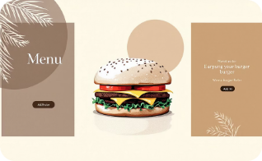
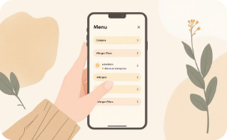

Frontend Requirements: User Experience & Design
Server-Side Templates
Interactive JavaScript
Visual Hierarchy
Django templates (HTML5 + CSS3) for SEO-friendly, indexable menus and content. Use Bootstrap for grid and responsive utilities.
Client-side behaviors: dynamic filtering, real-time cart updates, form validation, and progressive enhancement for offline resilience.
Large appetizing photos, clear CTAs, readable fonts and color accents (primary: #9C9283) to guide users to add items and complete checkout.

Slide 4
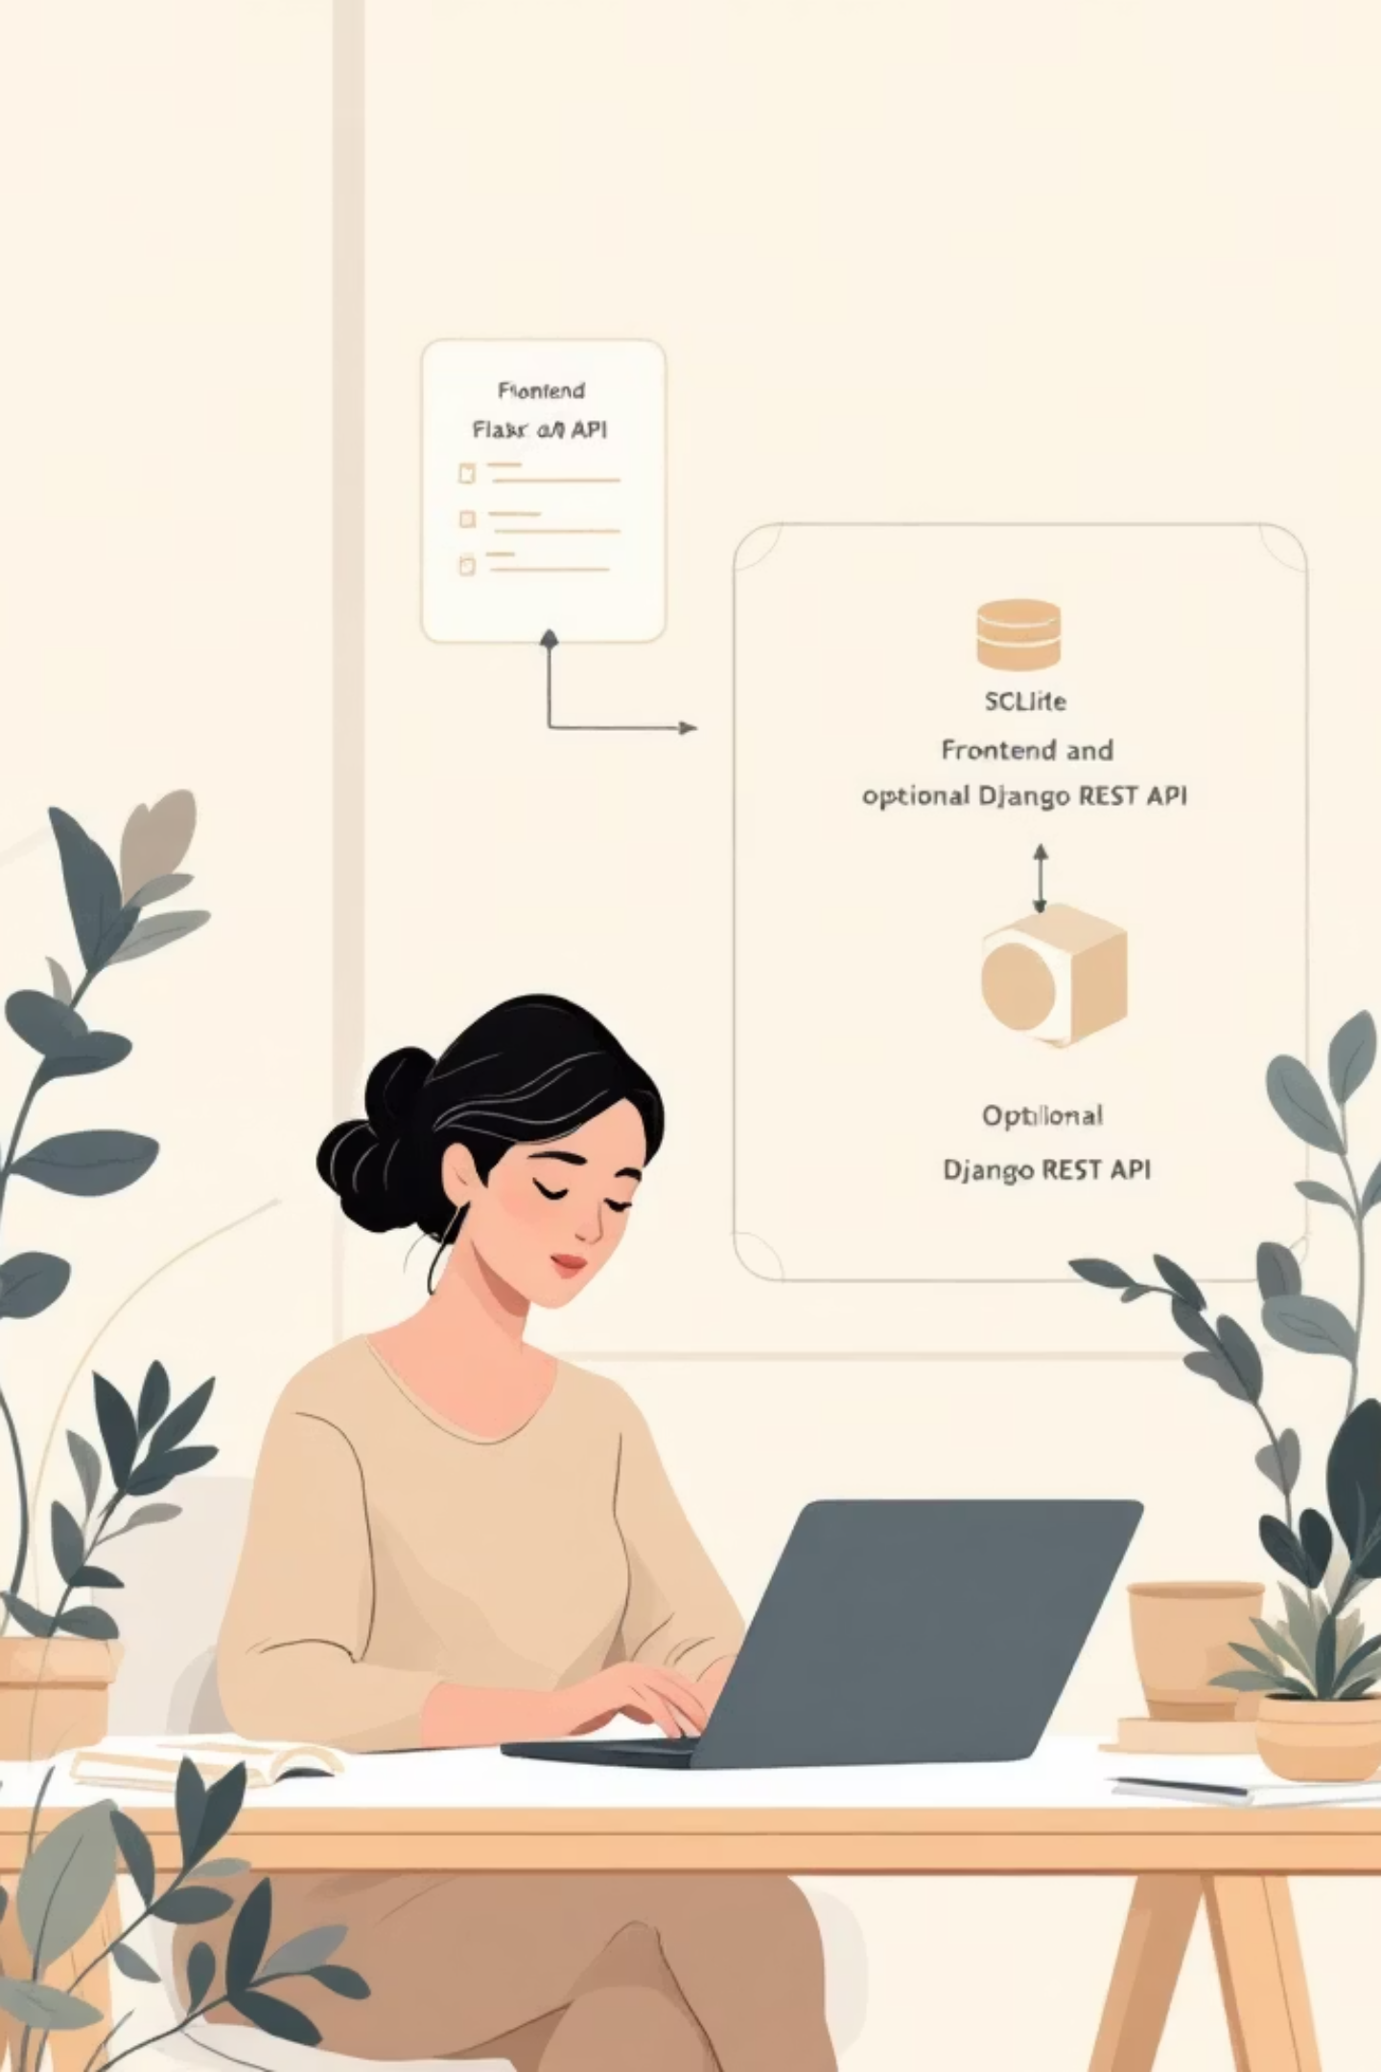

Backend Architecture: Robust & Flexible
Core Language: Python 3.x
Stable, well-supported language with a large ecosystem for web, data, and integrations.
Flask Backend
Lightweight API for order processing, webhooks, and POS/delivery integrations. Keeps services modular and testable.
Optional API Layer
Django REST Framework can be added for mobile apps, partner integrations, or a separate headless frontend in the future.
Database: SQLite 3
File-based database for small-to-medium restaurants; simple, portable, and easy to back up. Plan migration paths to PostgreSQL for scale.
Design the backend as composable services: authentication, menu management, order queue, payment connector, and notification worker processes.

Slide 5
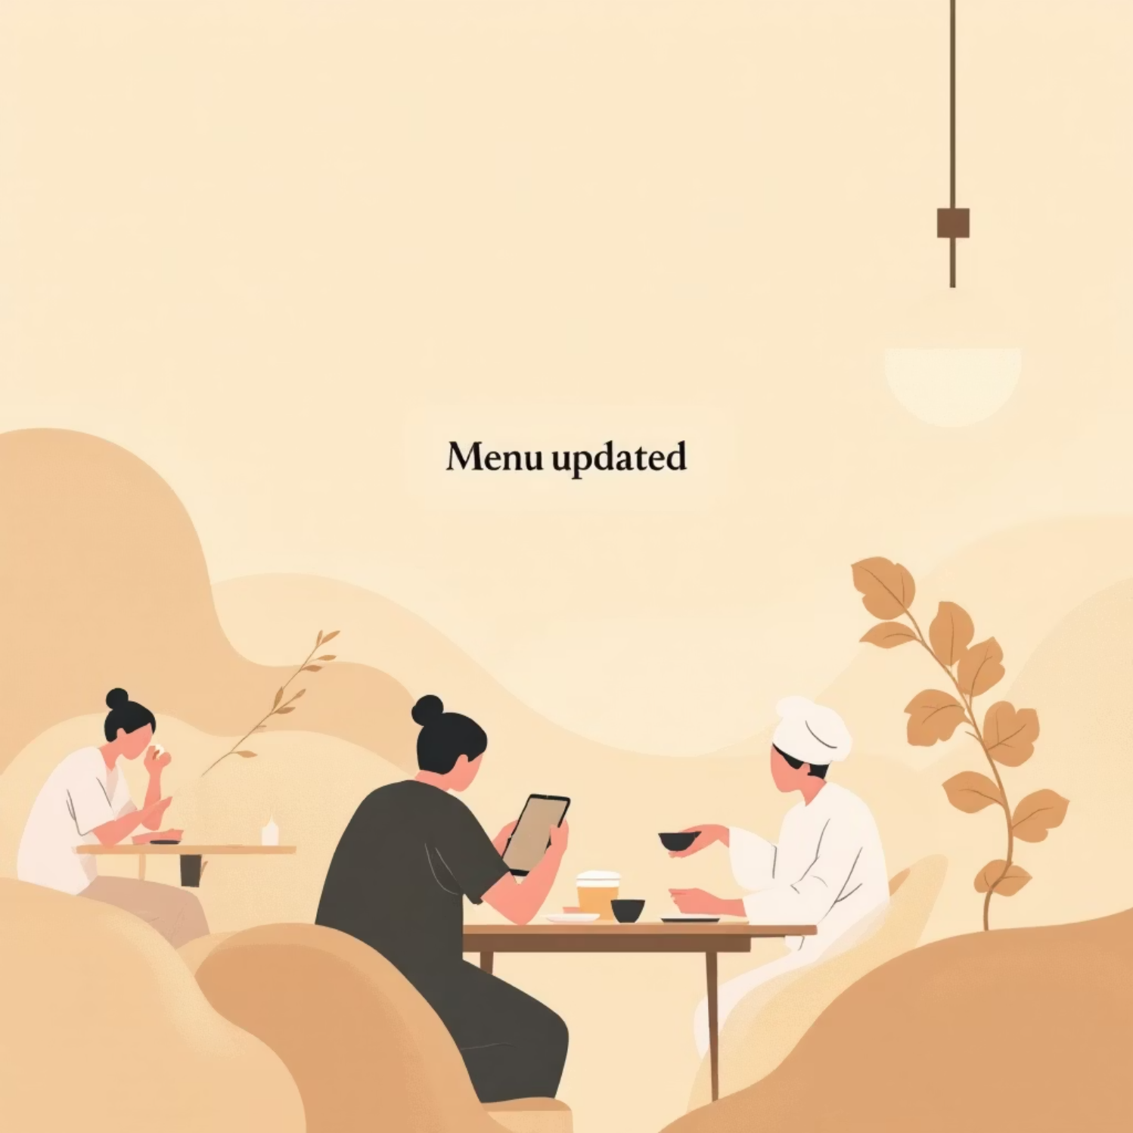
Dynamic Menu Management
The admin panel enables non-technical staff to add, edit, or remove items with live previews. Each item includes title, description, price, images, category, allergens, modifiers (sizes, extras), and availability windows.
Image uploads with auto-resize and lazy loading
Allergen & dietary tags for filtering and accessibility
Time-based availability (breakfast/lunch/dinner)
Real-time propagation of changes: WebSocket or short polling keeps the storefront in sync without redeploys. Versioned menu drafts let managers preview changes before publishing.

Slide 6
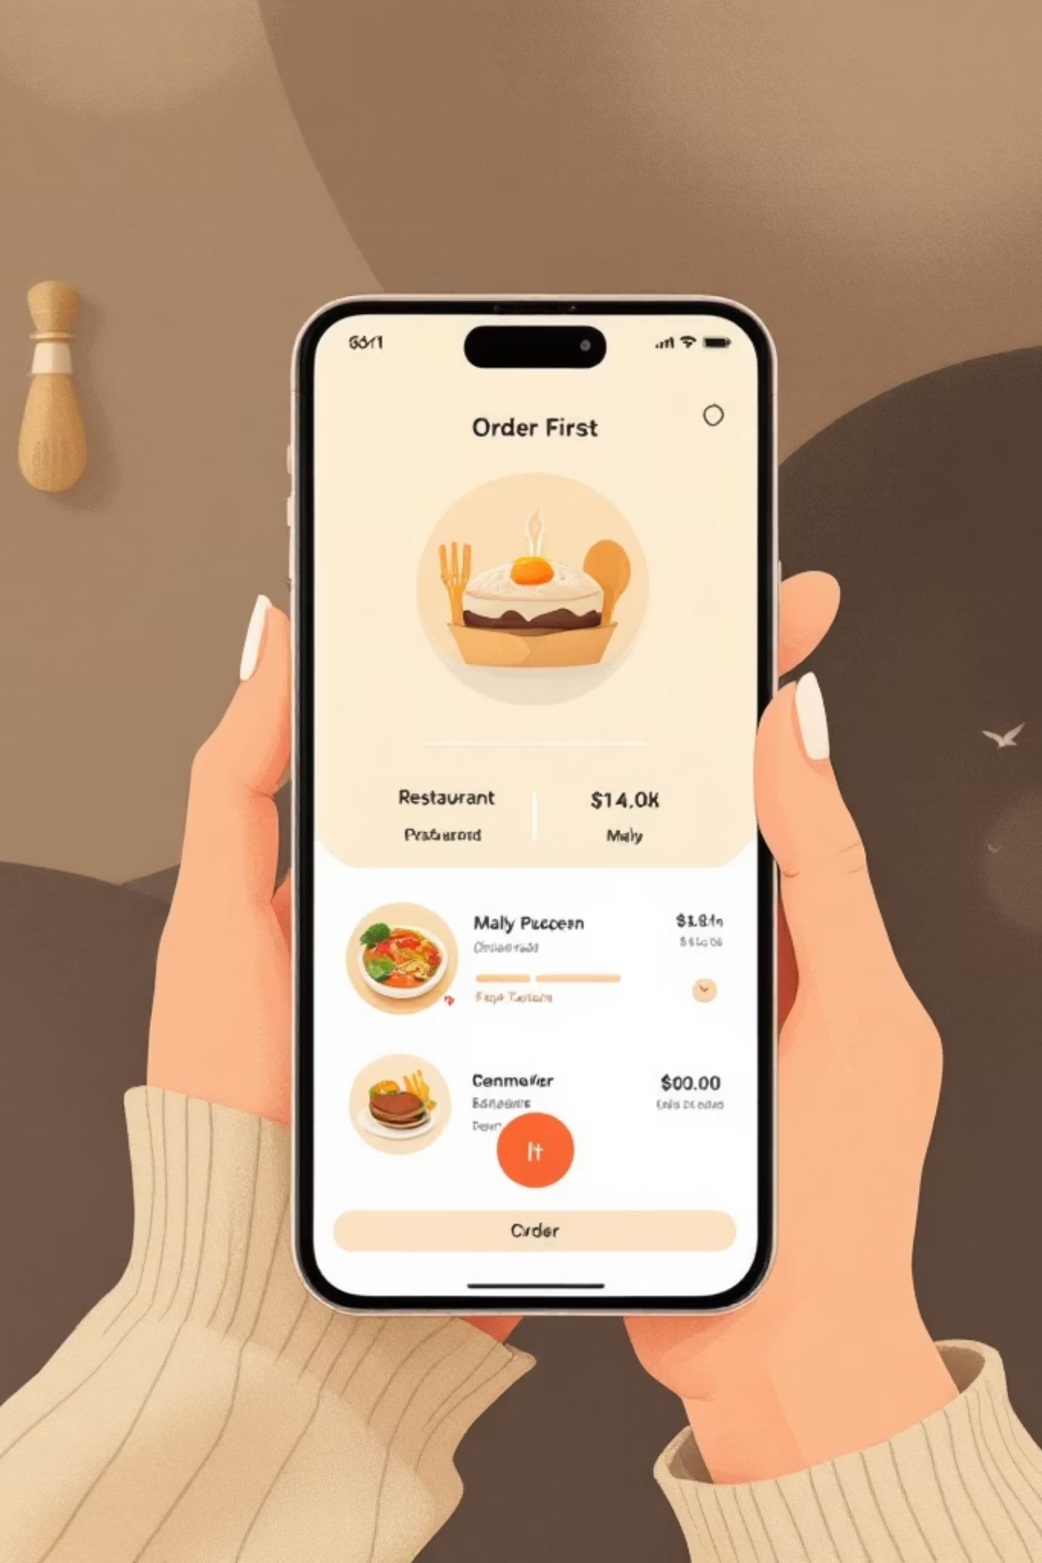
Responsive & Mobile-First Design Insights
Mobile Traffic & Expectations
Over 70% of visits originate from mobile. Prioritize fast paths to order and checkout on small screens.
Performance Targets
Aim for load times under 2 seconds. Optimize images, use CDN, and tune SQLite queries to avoid latency.
Interaction Design
Large tap targets, one-handed ergonomics, persistent cart access, and accessibility-compliant contrast using the theme palette (accent: #9C9283, dark text: #3A3A3A).
Use progressive enhancement: pages render server-side for crawlers and fallback devices, with client-side scripts adding dynamic convenience features.

Slide 7
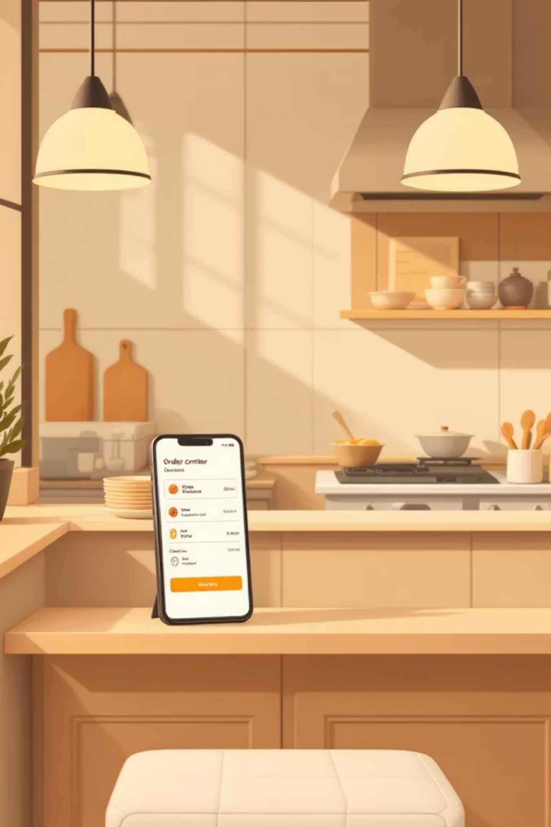

Online Ordering Workflow
Browse Menu
Select Items
View Cart
Checkout & Pay
The diagram shows a streamlined path: customers browse categories, customize items with modifiers, maintain a visible cart, and complete checkout in a few steps. The backend validates orders, deducts inventory where applicable, and triggers confirmation notifications and kitchen tickets.

Slide 8
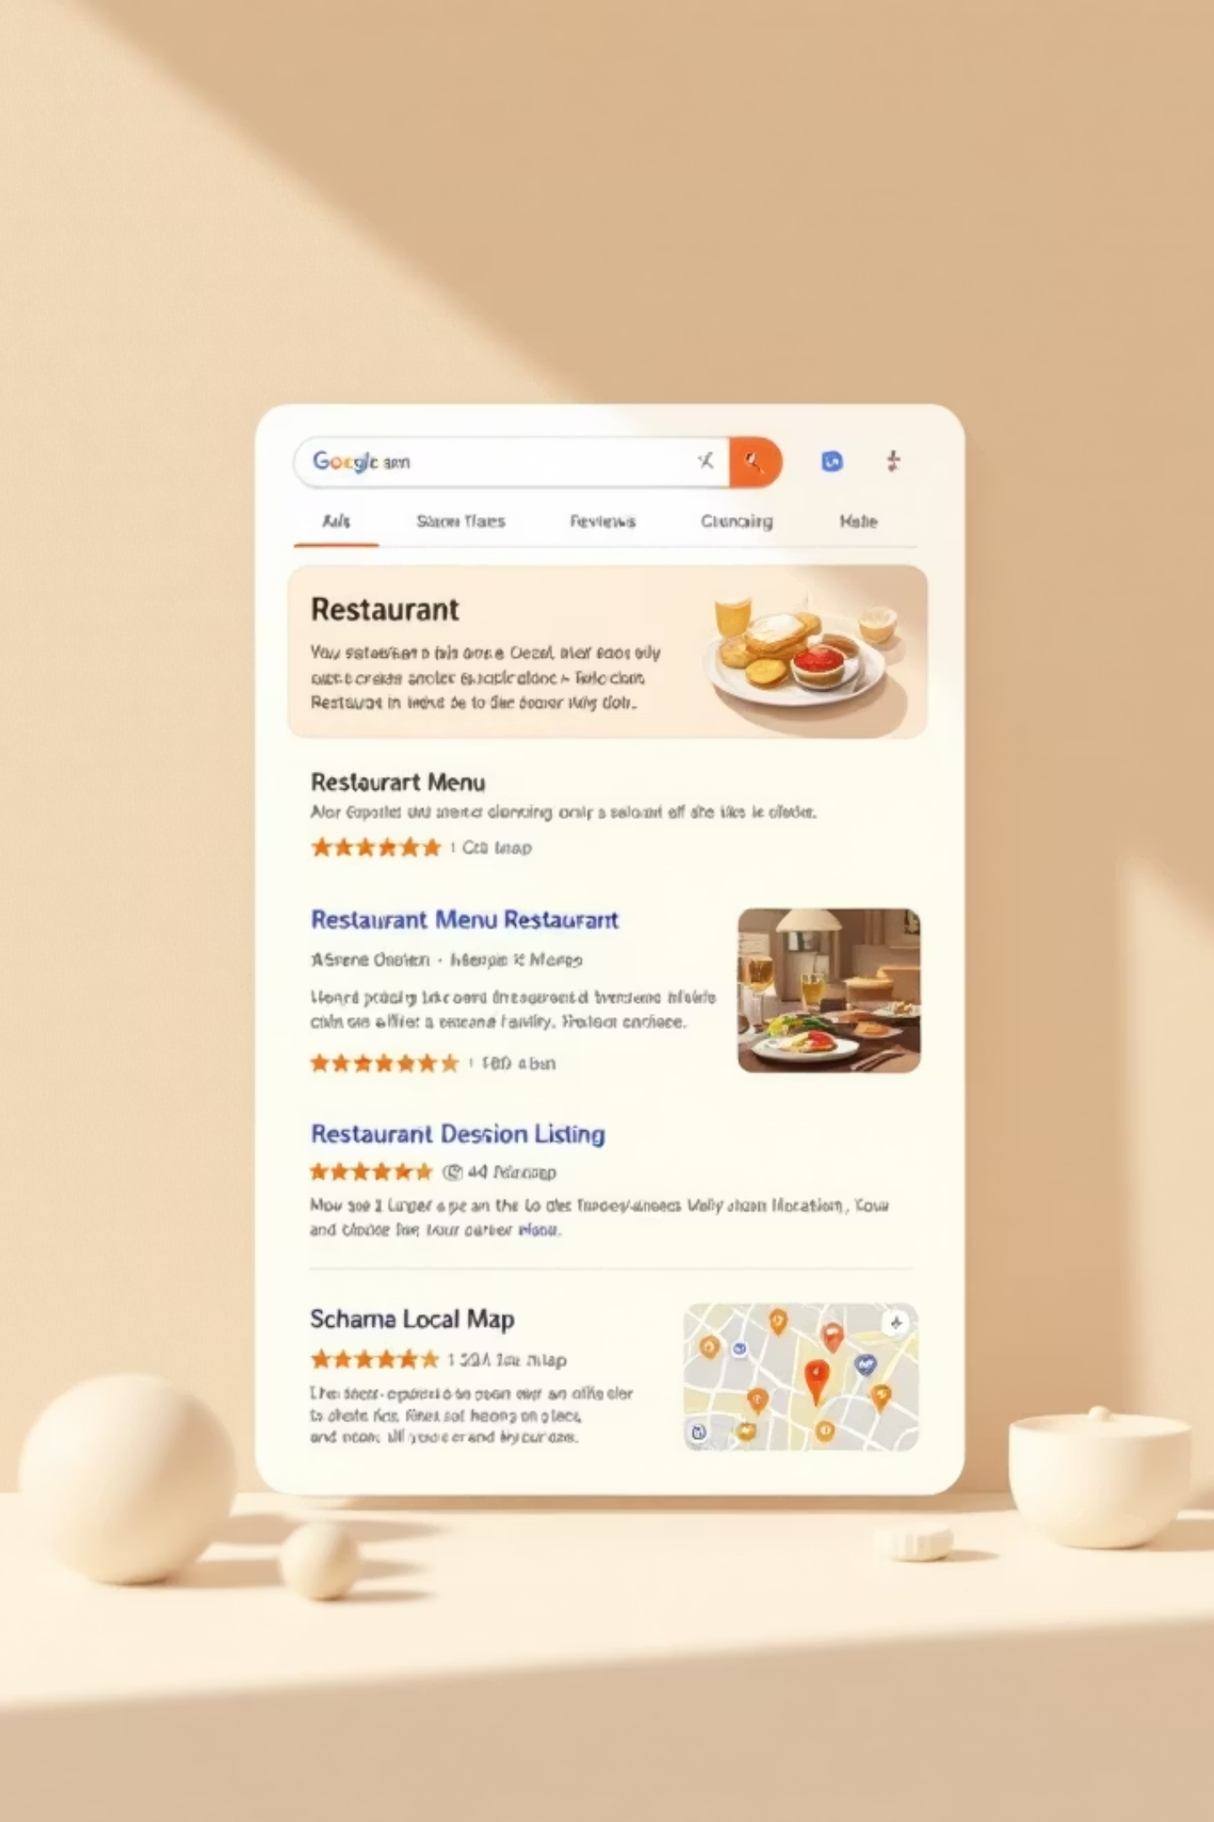
SEO & Marketing Considerations
Indexable HTML Menus
Use server-rendered HTML with structured data (schema.org/Menu and LocalBusiness) so search engines surface dishes and menu sections directly in local search.
Social Proof
Embed recent reviews, star ratings, and featured testimonials on the menu page to boost conversions and trust.
Capture Customers
Offer newsletter opt-in at checkout, first-order discounts, and targeted email campaigns tied to ordering behavior.
Local SEO fundamentals—consistent NAP, hours, and schema markup—improve discoverability for nearby hungry customers.

Slide 9

Challenges & Best Practices
Common Pitfalls
Recommended Best Practices
PDF-only menus that hurt SEO and accessibility
Outdated hours or menu items causing order failures
Unoptimized images and scripts slowing mobile experiences
Use HTML menus with ARIA roles for accessibility
Compress images, use responsive srcsets, lazy load off-screen media
Implement automated tests and cross-browser/device QA
Log key metrics: conversion rate, abandonment at cart, load times
Prepare a migration path from SQLite to PostgreSQL and from monolith to microservices as the business grows. Backups, monitoring, and rollback strategies are essential operational controls.

Slide 10

Conclusion: Building a Future-Ready Restaurant Website
Balanced Stack
Focus on UX
Combining Django templates, a Flask API layer, and SQLite delivers a pragmatic, maintainable starting point with clear upgrade paths.
Mobile-first design, fast performance, and clear CTAs increase conversion and repeat orders.
Ongoing Growth
Support marketing, analytics, and third-party integrations to turn the site into a long-term revenue channel.
Next steps: define data models and API endpoints, build an admin prototype for menu management, and run a pilot with live orders to validate assumptions and iterate quickly.

